Slide 1
ETL Data Pipeline Development Using SSIS for Amazon Product Data Cleaning

Slide 2
This project demonstrates how to clean Amazon product data using SQL Server Integration Services (SSIS).
Project Overview:
An ETL pipeline was developed using SSIS to clean Amazon product data. The process included:
Removing duplicates in the ASIN column.
Handling missing values (NULL) in key columns such as(product_price)
Exporting records with missing price values to Excel, and inserting complete records into a SQL Server database.

Slide 3
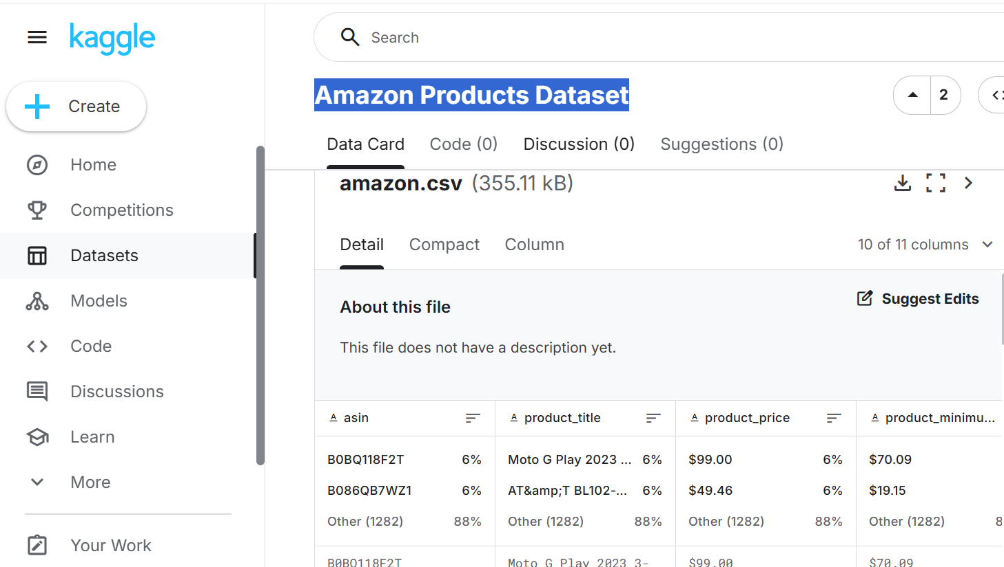
Amazon Products Dataset
https://www.kaggle.com/datasets/sharanv0402/amazon-products-dataset

Slide 4
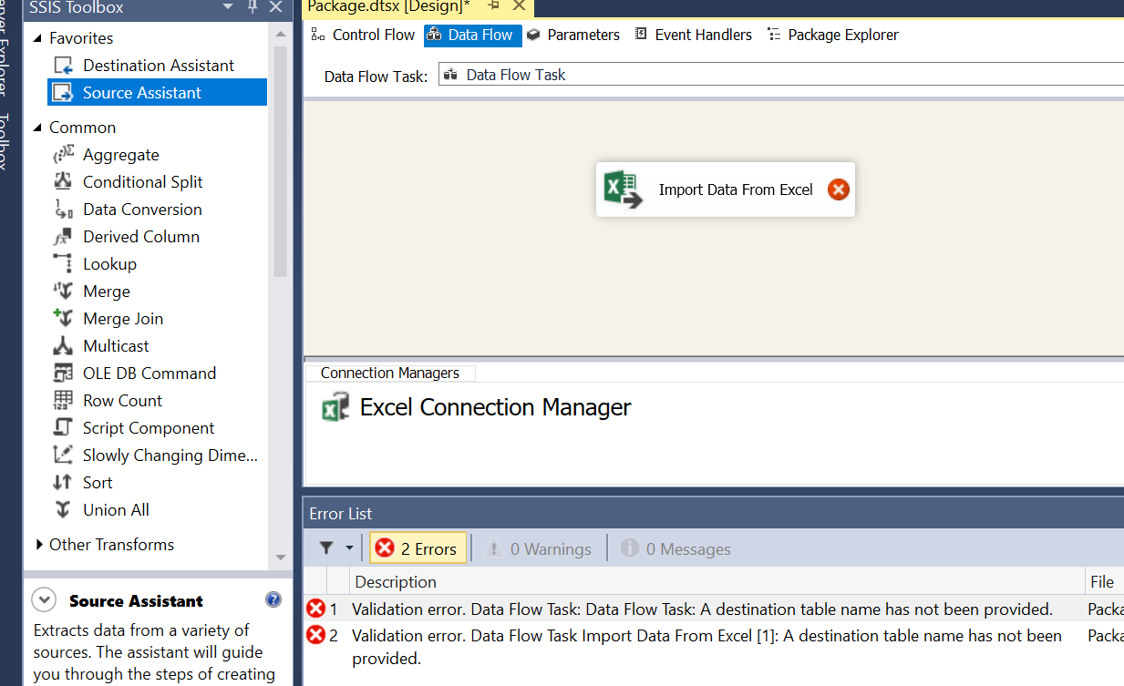

Slide 5
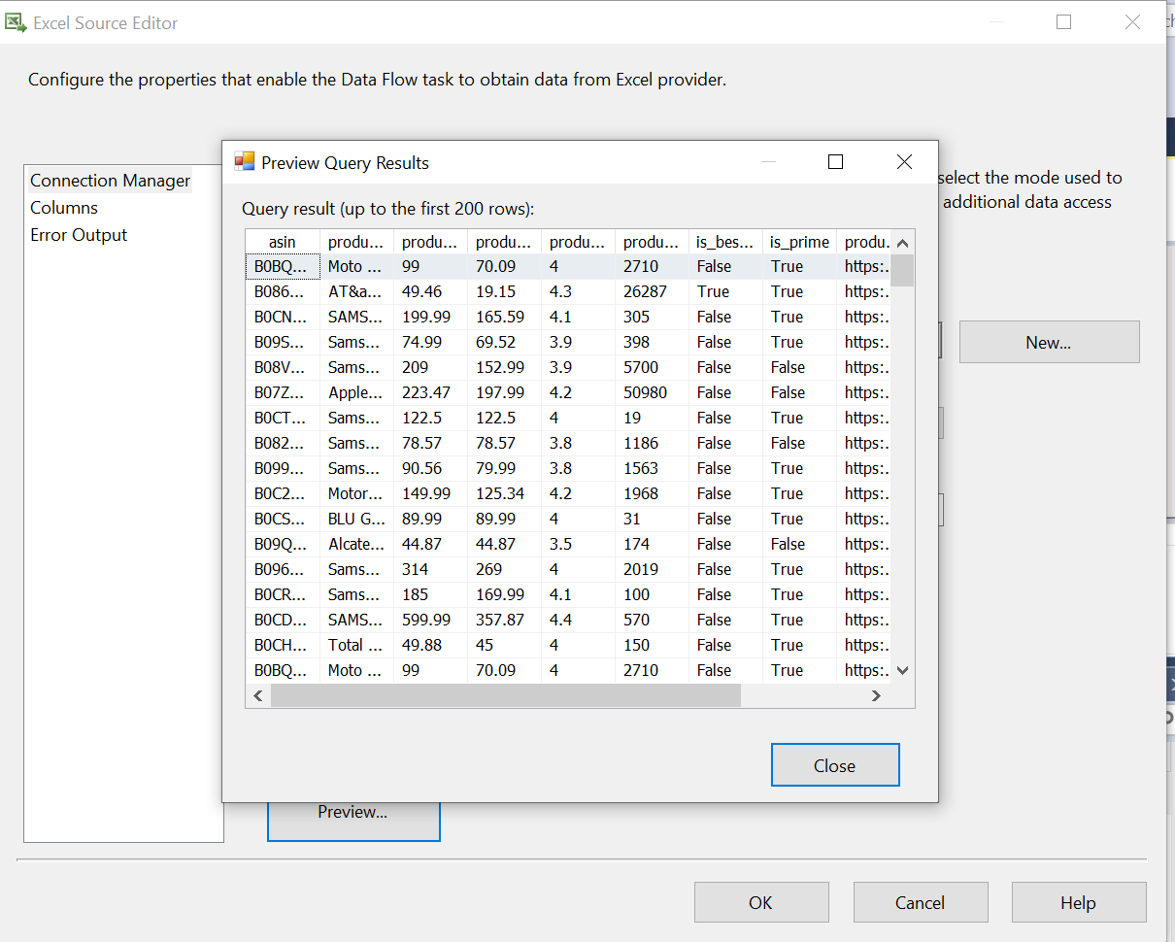
Import Data from Excel
Tool: Excel Source
Drag Excel Source from SSIS Toolbox to Data Flow.
Double-click and configure:
Choose your Excel file (amazon_products.xlsx)
Select the correct sheet
Preview to verify data.

Slide 6
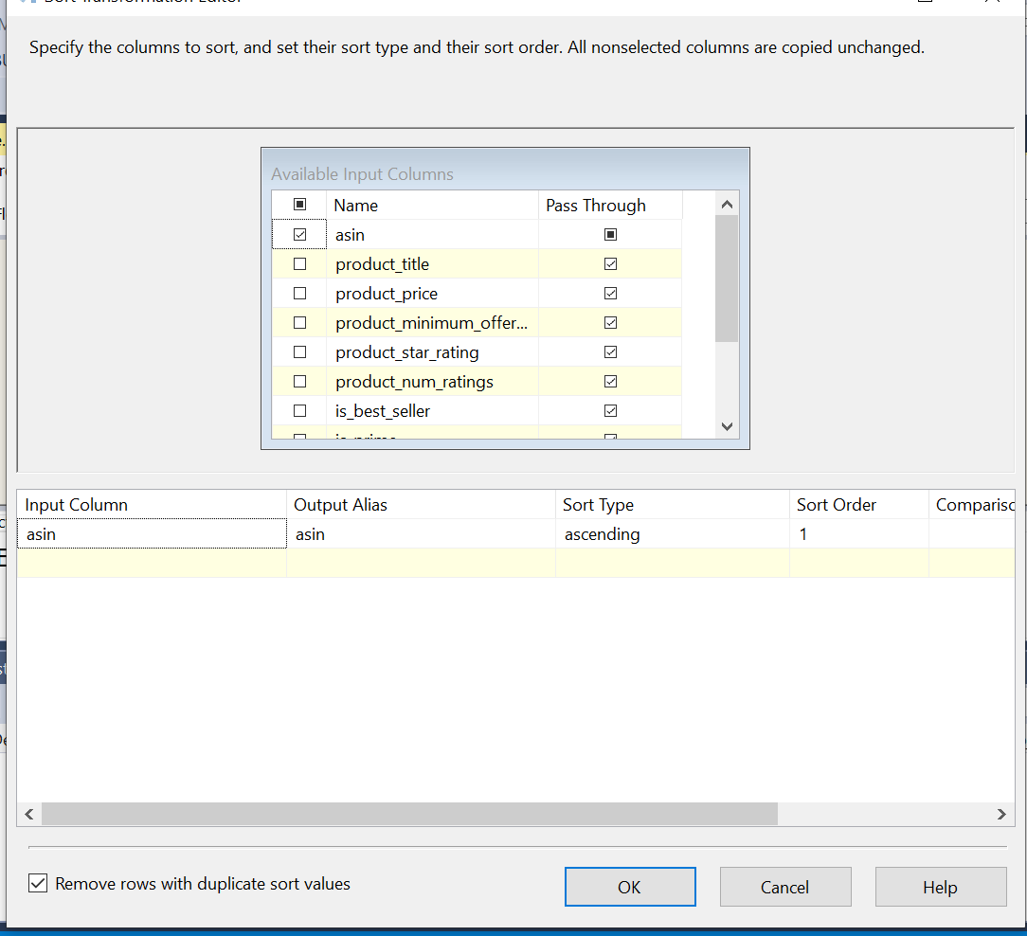
Sort Data by ASIN and Remove Duplicates
Tools:
Sort
Remove duplicates using the "Remove rows with duplicate sort values" option.
Steps:
Drag the Sort component.
Connect it to the Excel Source.
Sort by the ASIN column.
Check "Remove rows with duplicate sort values" (keeps the first occurrence).

Slide 7
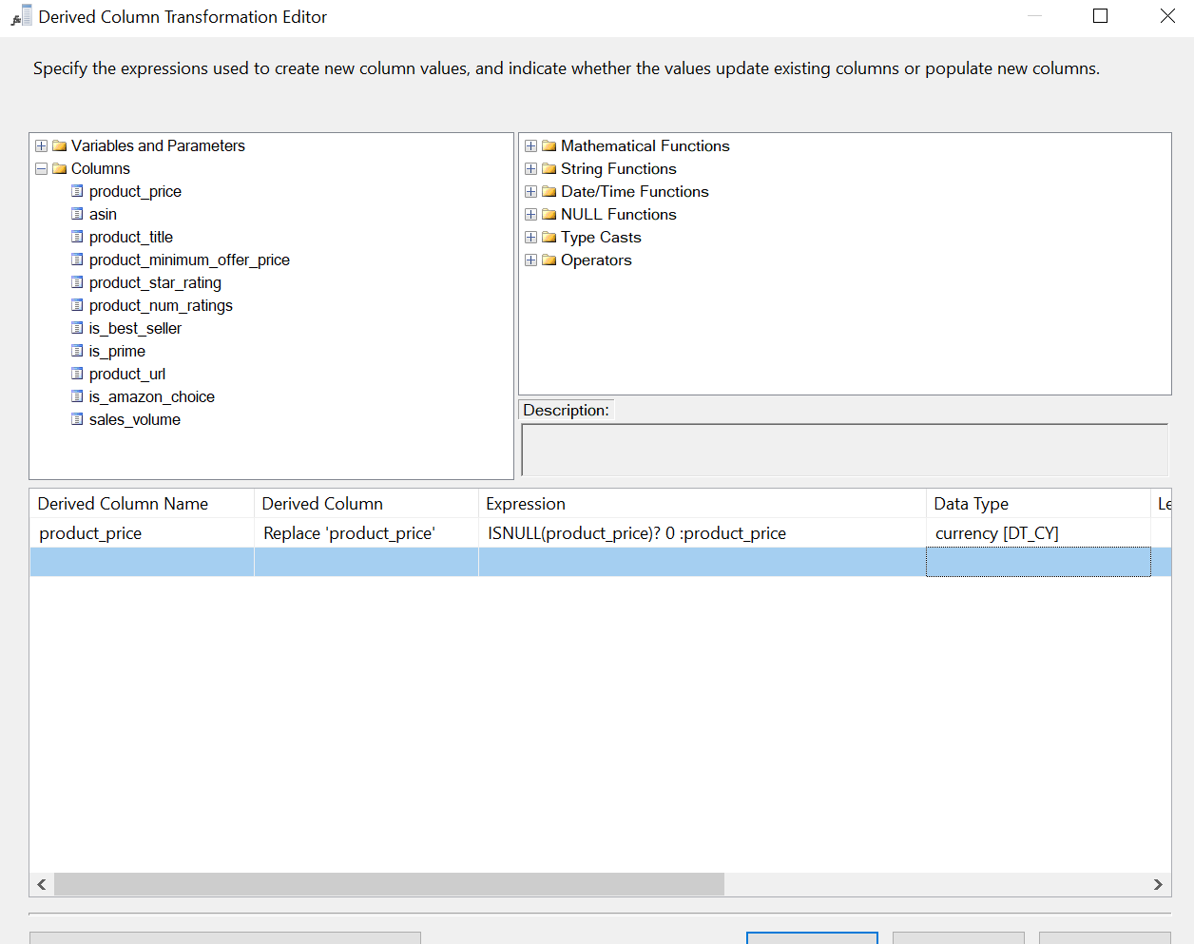
Replace Null Values
Tool: Derived Column or Replace Null Script Component
Steps:
Use Derived Column to replace NULLs.

Slide 8
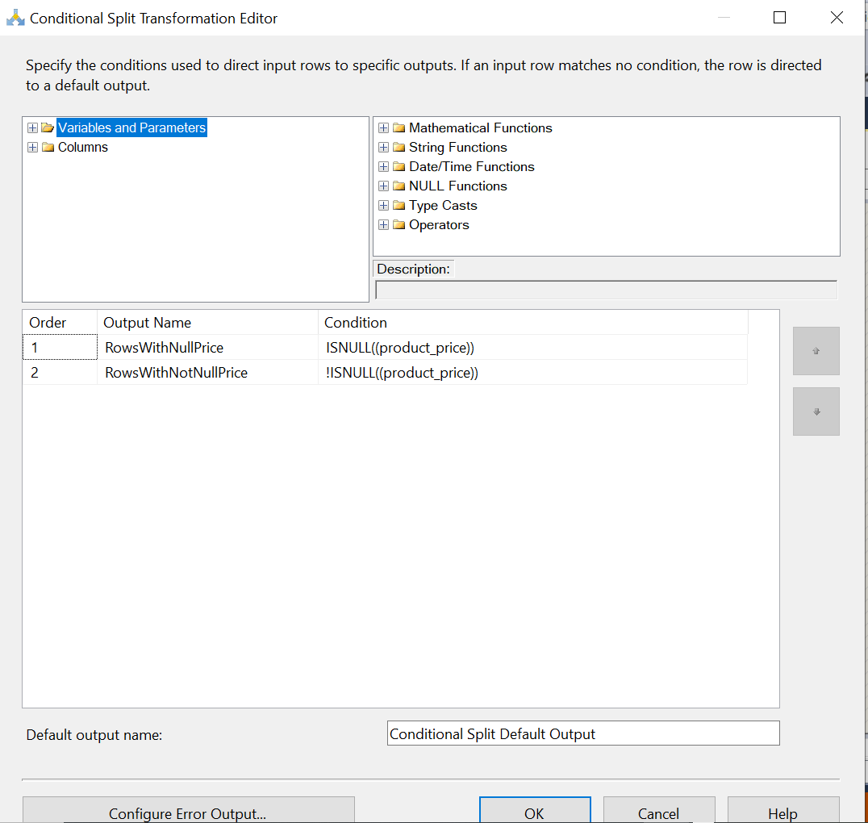
Split Rows Based on Null or Non-Null Price Values
Tool: Conditional Split
Steps:
Add Conditional Split to check Price column.

Slide 9
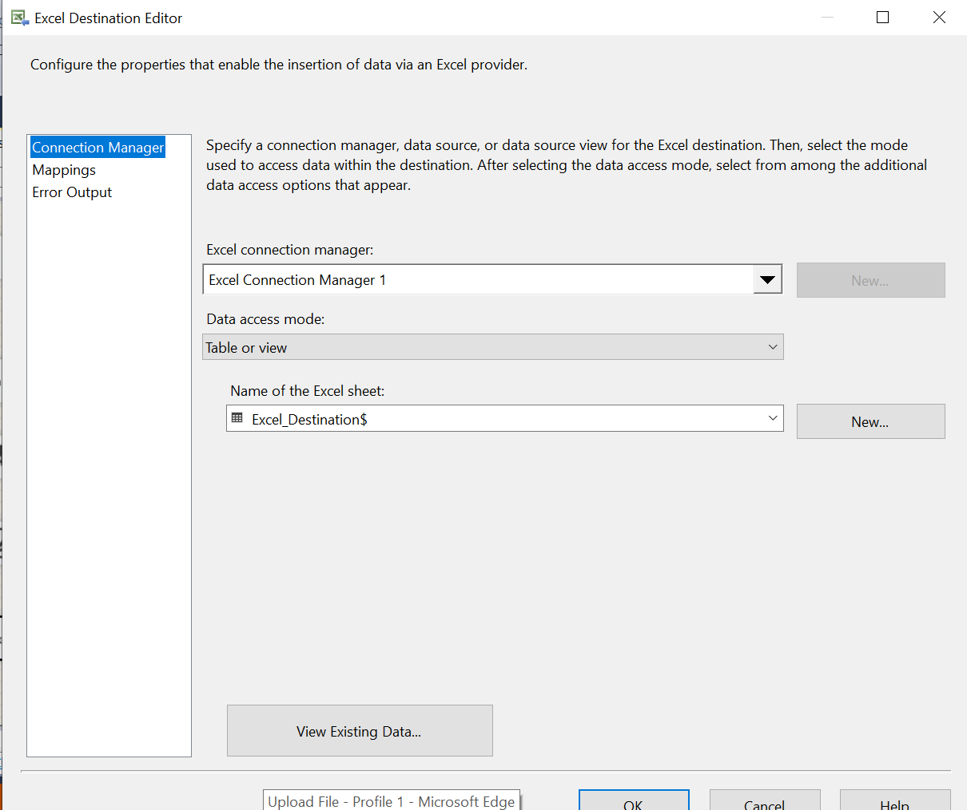
Export Rows with Null Price to Excel
Tool: Excel Destination
Steps:
Connect the "Null Price" output from Conditional Split.
Use Excel Destination and map the columns.
Configure to write to a new Excel fil

Slide 10
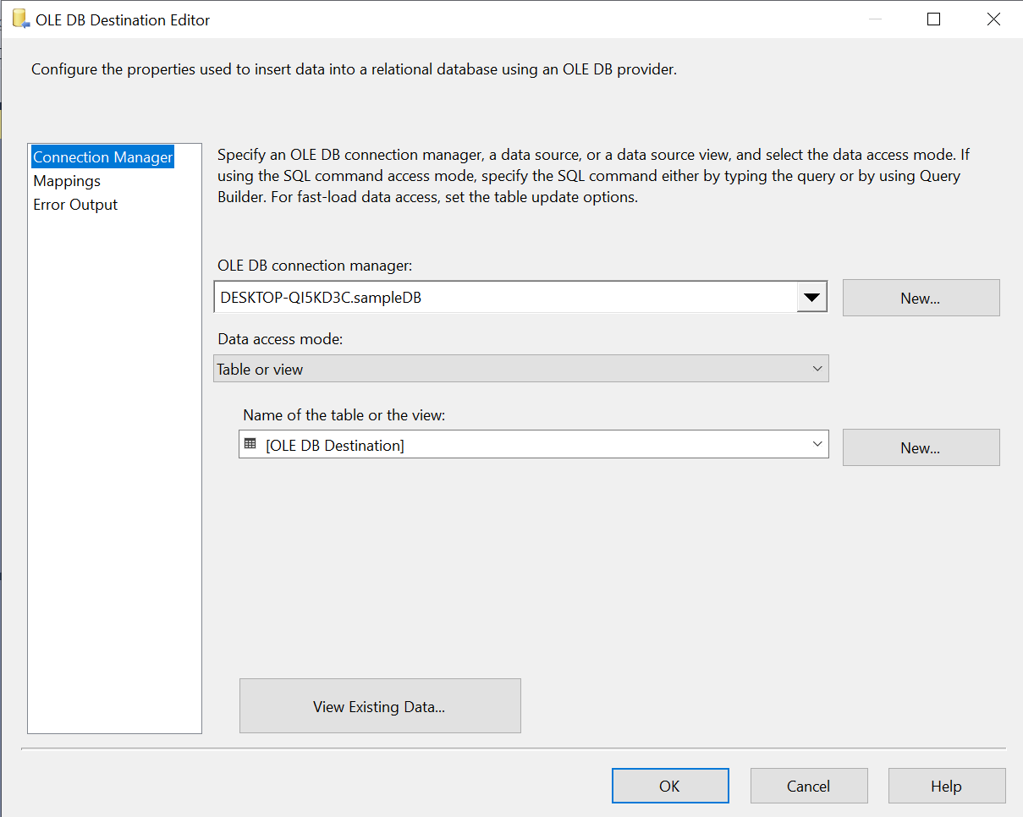
Insert Rows with Non-Null Price into Database Table
Steps:
Connect "Non-null Price" output to OLE DB Destination.
Create a target table in SQL Server (e.g., Amazon_Products_Cleaned).
Map columns from your source to destination.
Use data viewer to monitor flow (optional).

Slide 11
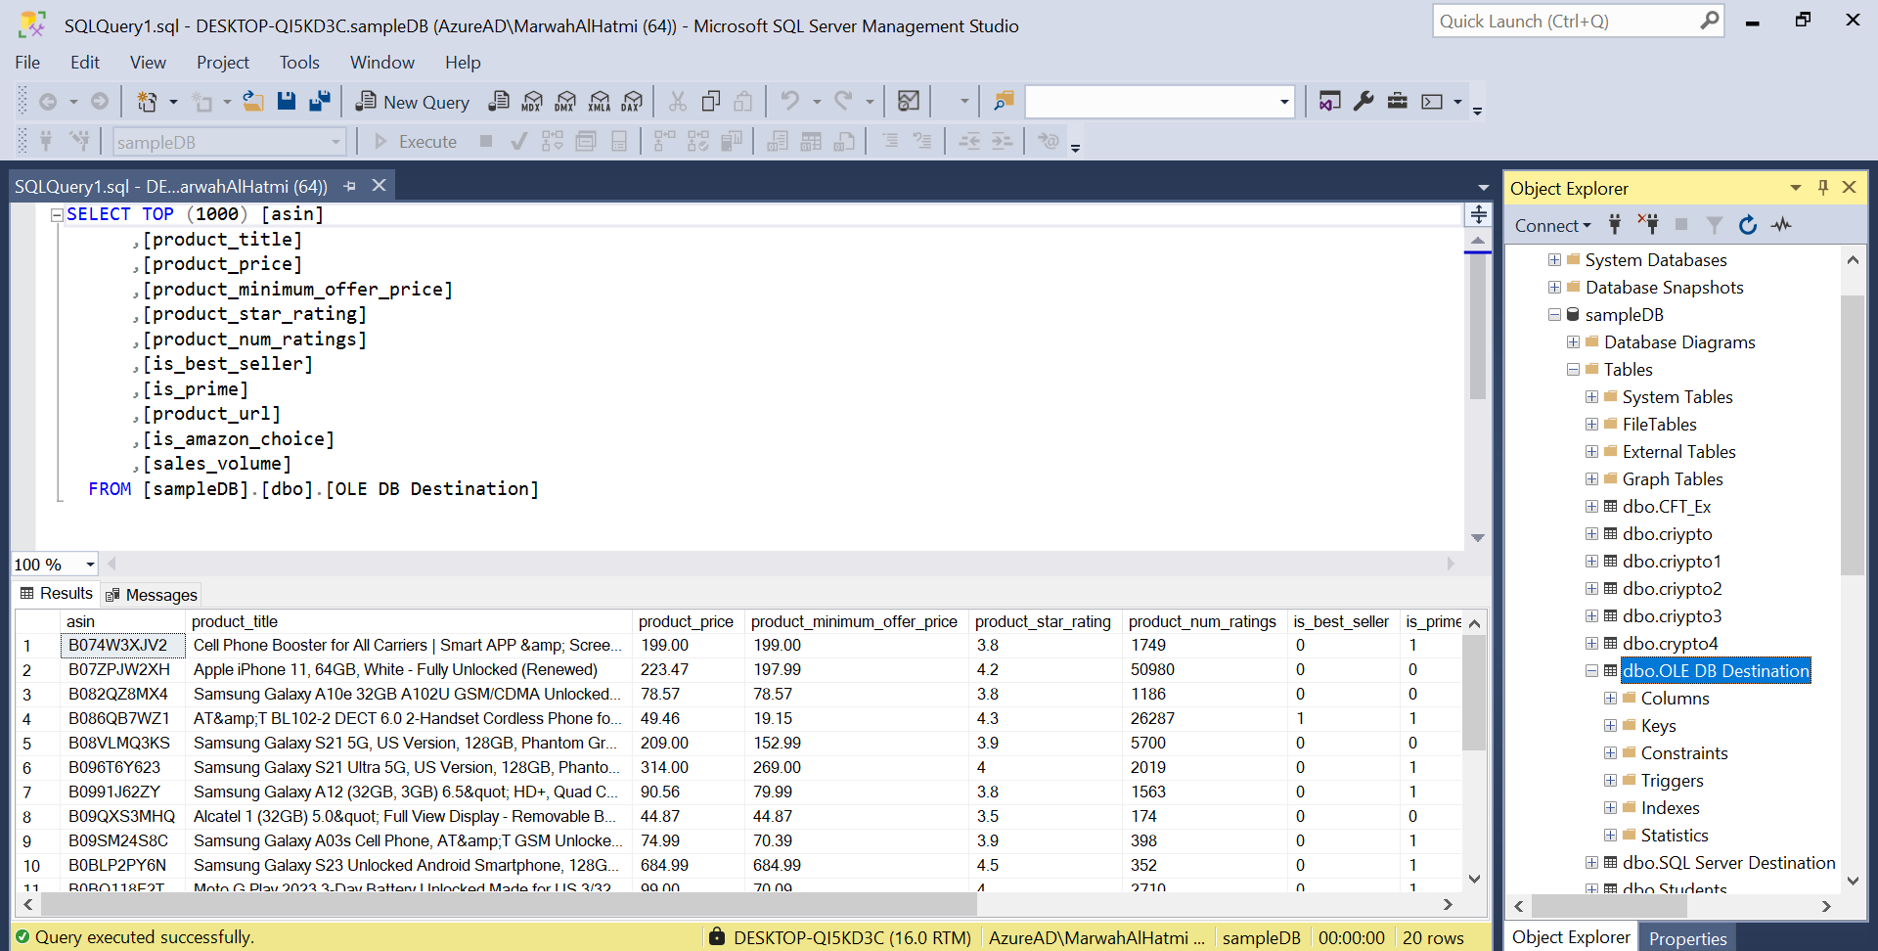

Slide 12
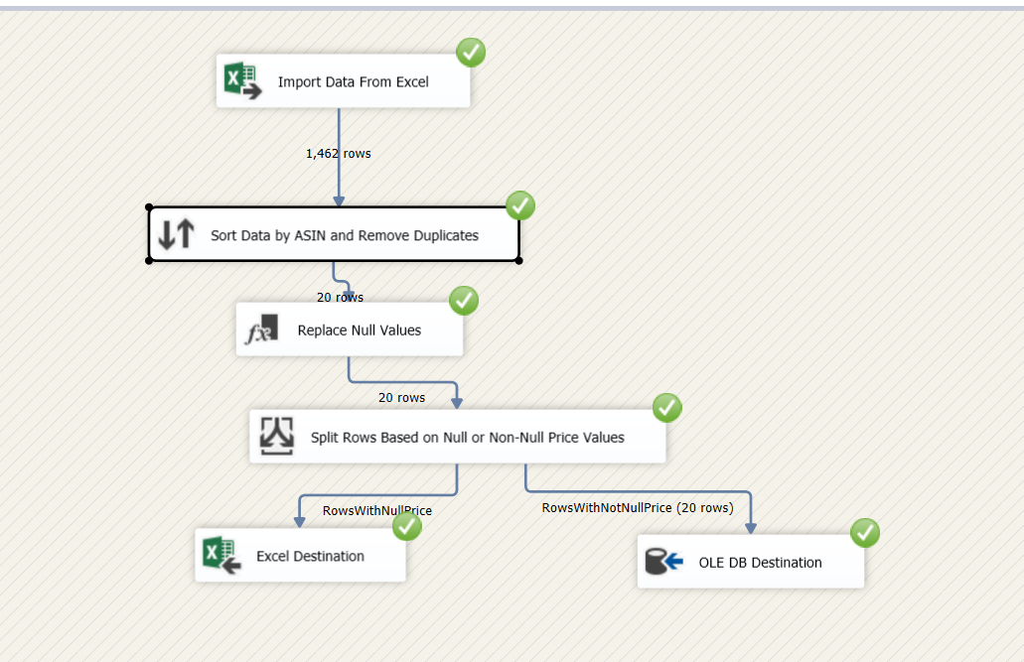
🔄 Data Flow:

Slide 13
Process Summary
Import data from Excel.
Sort and remove duplicate ASIN values.
Replace missing values with defaults.
Split data based on price presence.
Load cleaned data into SQL Server database.
Export incomplete records for further review.

Slide 14
Conclusion
This project demonstrates how to clean and transform Amazon product data using SSIS. The ETL process involved:
Removing duplicates.
Handling missing values.
Dropping irrelevant columns.
Loading clean data into SQL Server for further analysis.

